Slide 1

POWER BI PROJECT
BANK LOAN REPORT

Slide 2
PROBLEM STATEMENT
OBJECTIVE:
To monitor and assess our bank's lending activities, focusing on loan metrics to enhance decision-making and strategy formulation.
NEED:
Insights into loan performance over time for tracking loan portfolio health, understanding trends, and supporting risk management.
GOAL:
Provide a comprehensive report on loan metrics to improve lending strategies, customer insights, and profitability.

Slide 3
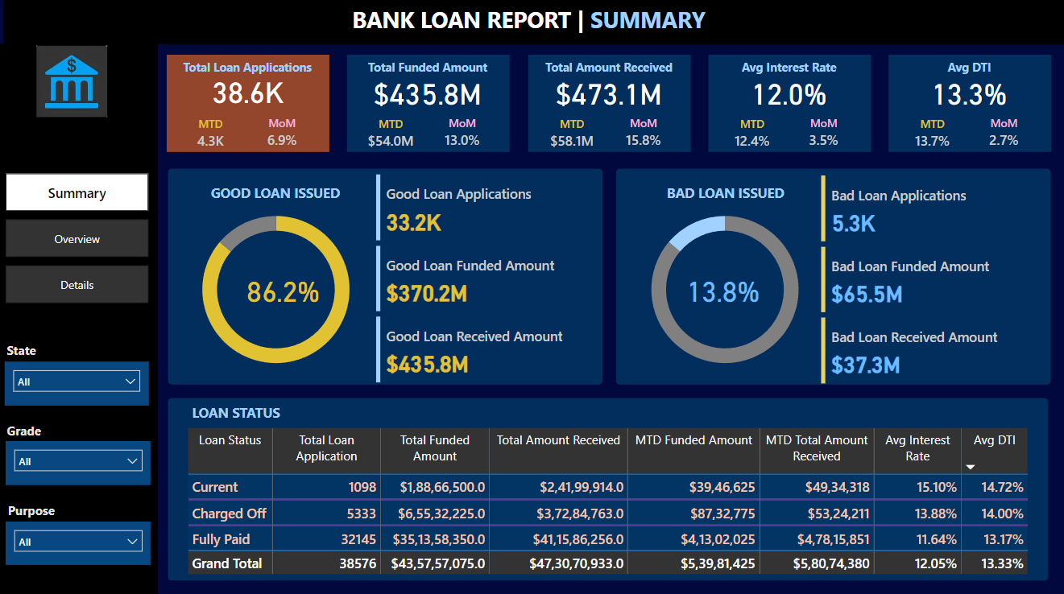

Slide 4
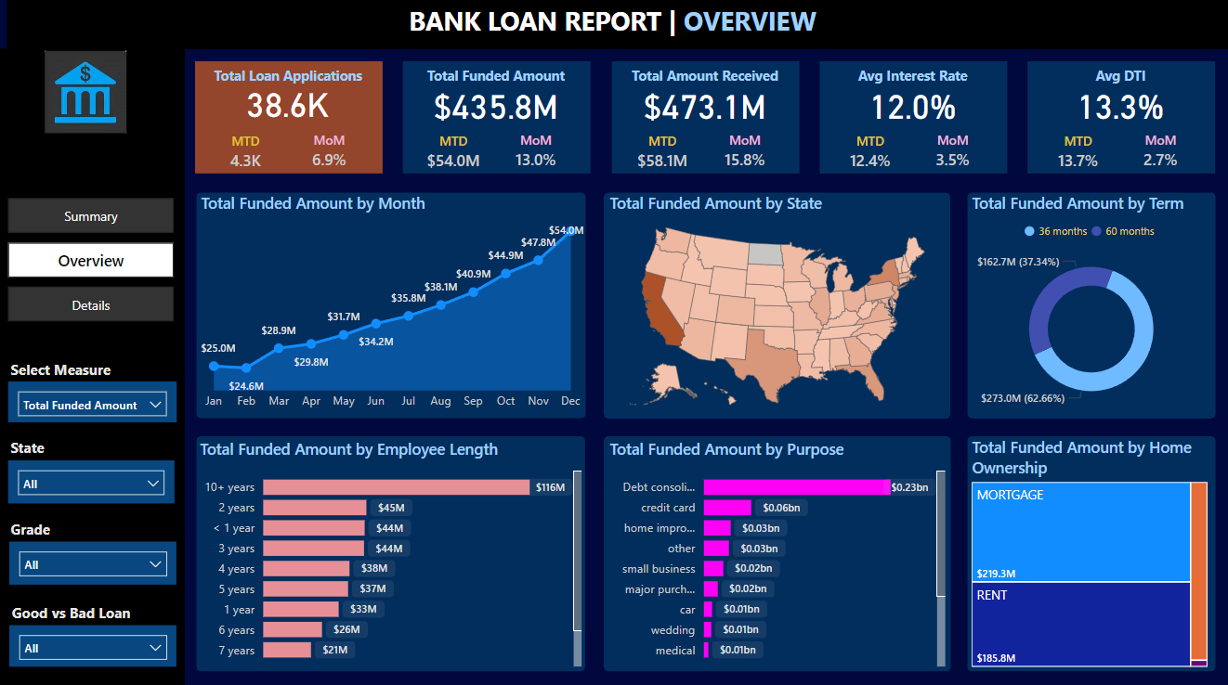

Slide 5
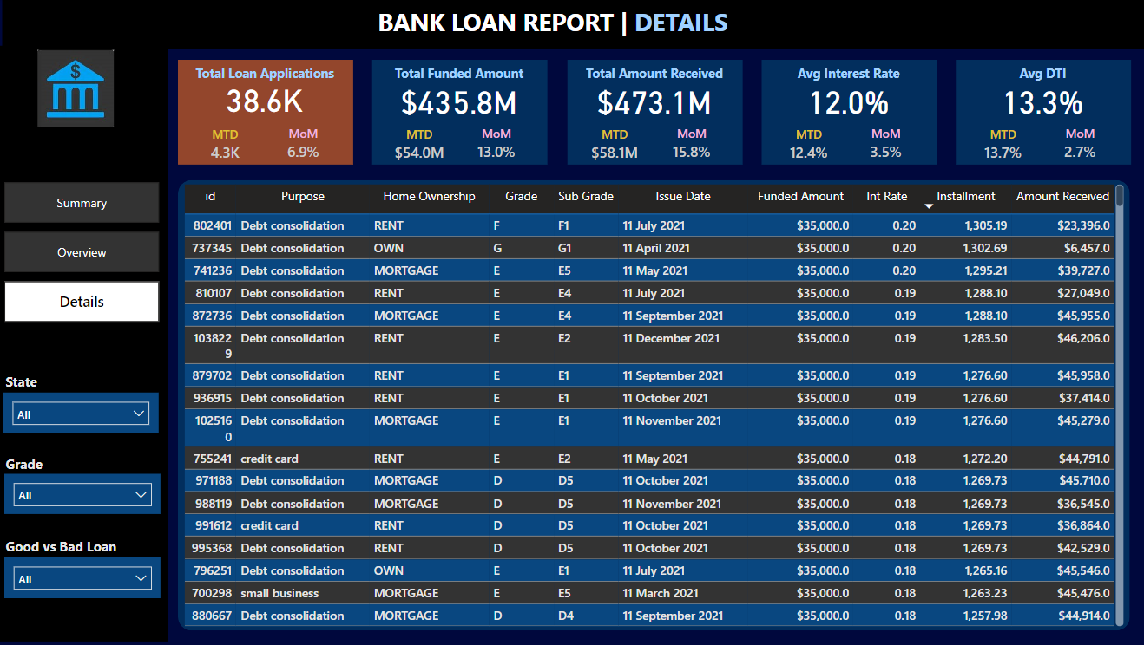

Slide 6
PURPOSE: Dashboard 1 offers a high-level summary of loan-related metrics to aid in tracking performance.
DASHBOARD 1: SUMMARY
Key Performance Indicators (KPIs) Requirements:
Total Loan Applications: We need to calculate the total number of loan applications received during a specified period. Additionally, it is essential to monitor the Month-to-Date (MTD) Loan Applications and track changes Month-over-Month (MoM).
Total Funded Amount: Understanding the total amount of funds disbursed as loans is crucial. We also want to keep an eye on the MTD Total Funded Amount and analyse the Month-over-Month (MoM) changes in this metric.
Total Amount Received: Tracking the total amount received from borrowers is essential for assessing the bank's cash flow and loan repayment. We should analyse the Month-to-Date (MTD) Total Amount Received and observe the Month-over-Month (MoM) changes.
Average Interest Rate: Calculating the average interest rate across all loans, MTD, and monitoring the Month-over-Month (MoM) variations in interest rates will provide insights into our lending portfolio's overall cost.
Average Debt-to-Income Ratio (DTI): Evaluating the average DTI for our borrowers helps us gauge their financial health. We need to compute the average DTI for all loans, MTD, and track Month-over-Month (MoM) fluctuations.

Slide 7
DASHBOARD 1: SUMMARY
Good Loan v Bad Loan KPI’s
OBJECTIVE:
In order to evaluate the performance of our lending activities and assess the quality of our loan portfolio, we need to create a comprehensive report that distinguishes between 'Good Loans' and 'Bad Loans" based on specific loan status criteria
Good Loan:
Good Loan Application Percentage
Good Loan Applications
Good Loan Funded Amount
Good Loan Total Received Amount
Bad Loan:
Bad Loan Application Percentage
Bad Loan Applications
Bad Loan Funded Amount
Bad Loan Total Received Amount
INSIGHT:
By segmenting loans, we can focus on improving application quality and fund allocation.

Slide 8
DASHBOARD 1: SUMMARY
Loan Status Grid View
OBJECTIVE:
A grid view categorizes loans by 'Loan Status,' providing a consolidated overview.
KEY METRICS
Total Loan Applications
Total Funded Amount
Total Amount Received
Month-to-Date (MTD) Funded Amount
MTD Amount Received
Average Interest Rate
Average Debt-to-Income Ratio (DTI)

Slide 10
DASHBOARD 2: OVERVIEW
GOAL:
Visually represent key trends and metrics across the loan portfolio to identify trends and assess regional or demographic variations.
CHARTS
Monthly Trends by Issue Date (Area Chart): To identify seasonality and long-term trends in lending activities
Regional Analysis by State (Shape Map): To identify regions with significant lending activity and assess regional disparities
Loan Term Analysis (Donut Chart): To allow the client to understand the distribution of loans across various term lengths.
Employee Length Analysis (Bar Chart): How lending metrics are distributed among borrowers with different employment lengths, helping us assess the impact of employment history on loan applications.
Loan Purpose Breakdown (Bar Chart): Will provide a visual breakdown of loan metrics based on the stated purposes of loans, aiding in the understanding of the primary reasons borrowers seek financing.
Home Ownership Analysis (Tree Map): For a hierarchical view of how home ownership impacts loan applications and disbursements.

Slide 12
DASHBOARD 3: DETAILS
PURPOSE:
Need for a comprehensive 'Details Dashboard' that provides a consolidated view of all the essential information within our loan data.
OBJECTIVE:
The primary objective of the Details Dashboard is to provide a comprehensive and user-friendly interface for accessing vital loan data. It will serve as a one-stop solution for users seeking detailed insights into our loan portfolio, borrower profiles, and loan performance.
OUTCOME:
Facilitates in-depth analysis and quick reference for decision-making.

Slide 14
KEY INSIGHTS AND ANALYSIS
Loan Applications & Trends:
Insights into peak periods and regional loan demand.
Portfolio Performance:
Differentiating between performing ('Good') and non-performing ('Bad') loans to mitigate risks.
Demographic Insights:
Analysis of employment length and homeownership on loan success rates.
Loan Purpose & Borrower Profile:
Understanding borrower motivations and financial profiles to guide product offerings.

Slide 15
CONCLUSION
SUMMARY:
This Bank Loan Analysis provides critical insights into our lending portfolio, highlighting areas of high performance and identifying risk factors.
DATA-DRIVEN DECISION-MAKING:
Enables improved risk assessment, targeted lending strategies, and operational efficiency.
FUTURE STEPS:
Utilize these insights to refine credit policies, enhance customer offerings, and monitor key metrics for ongoing portfolio health.

Slide 16
THANK YOU

